Slide 1
Breaking Writer’s Block: Low-cost Fine-tuning of Natural Language Generation Models
EACL 2021 Submission
Alexandre Duval
alexandre.duval@student-cs.fr
Thomas Lamson
contact@thomas-Lamson.com
Gaël de Léséleuc de Kérouara
gael.dldk@pm.me
Matthias Gallé
matthias.galle@naverlabs.com

Slide 2


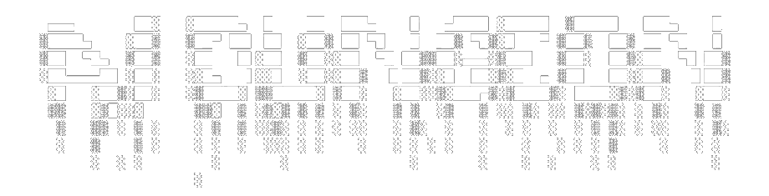
Introduction
A few examples…
Transformer Model
Transformer Model of increased size
GROVER
Generation and detection of Neural Fake News
Contextualized text generation experiment

Slide 3
Introduction
Costly to train
Struggle to maintain consistent context
Generation is hard to steer
GROVER

Slide 4
Problem Definition
Objective: Generate text…
1/ In a controlled fashion according to several dimensions
2/ In the specific context of novel writing
3/ At an affordable cost

Slide 5

Problem Definition
Objective: Generate text…
1/ In a controlled fashion according to several dimensions
2/ In the specific context of novel writing
3/ At an affordable cost
P1
P2
P3
FINE-TUNED
Novel Genre, Entities in P2
Length of P2, Summary of P2

Slide 6
Data Preparation
Automatic Retrieval from GUTENBERG PROJECT
313 BOOKS
METADATA

Slide 7
Data Preparation
Paragraph Splitting
Split each novel into paragraphs
· preserving sentence syntax
· three different sizes
Automatic Retrieval from GUTENBERG PROJECT
313 BOOKS
METADATA

Slide 8
Data Preparation
Paragraph Splitting
Split each novel into paragraphs
· preserving sentence syntax
· three different sizes
Automatic Retrieval from GUTENBERG PROJECT
313 BOOKS
Entity Recognition
Identify all entities in each paragraph
· using BERT-NER
· sorted into four categories
METADATA

Slide 9
Data Preparation
Paragraph Splitting
Split each novel into paragraphs
· preserving sentence syntax
· three different sizes
Automatic Retrieval from GUTENBERG PROJECT
313 BOOKS
Entity Recognition
Identify all entities in each paragraph
· using BERT-NER
· sorted into four categories
METADATA
Summarization
Produce four summaries for each paragraph, using:
· T5 · BART
· BertSum · Keywords

Slide 10
Data Preparation
Paragraph Splitting
Split each novel into paragraphs
· preserving sentence syntax
· three different sizes
Automatic Retrieval from GUTENBERG PROJECT
PROCESSED DATA
134’000 Examples
P1: previous paragraph
P2: paragraph of interest
P3: following paragraph
Ent: list of entities in P2
Sum: 4 summaries of P2
Genre: novel theme
Size: length of P2
313 BOOKS
Entity Recognition
Identify all entities in each paragraph
· using BERT-NER
· sorted into four categories
METADATA
Summarization
Produce four summaries for each paragraph, using:
· T5 · BART
· BertSum · Keywords

Slide 11
Model
P3
Summaries
Theme & Size
Entities
P1
P2
Tokens
[PAD]
[P3]
...
[SUM]
...
[T]
[S]
[ENT]
...
[P1]
...
[P2]
...
?
Segment
[PAD]
[P3]
[SUM]
[T]
[S]
[ENT]
[P1]
[P2]

Slide 12
Model
P3
Summaries
Theme & Size
Entities
P1
P2
Tokens
[PAD]
[P3]
...
[SUM]
...
[T]
[S]
[ENT]
...
[P1]
...
[P2]
...
?
Segment
[PAD]
[P3]
[SUM]
[T]
[S]
[ENT]
[P1]
[P2]
Token Score (logit)
Tokens Embedding
(
Use of NUCLEUS SAMPLING strategy
)
Chosen Token
…
-0,5114
0,0014
…
-0,0173
0,0022
0,7830
0,1907
TOKEN
Output Vector

Slide 13
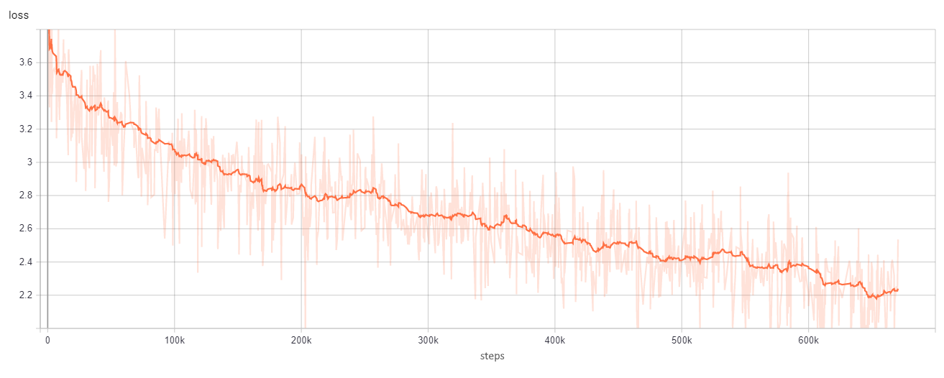
Model
P3
Summaries
Theme & Size
Entities
P1
P2
Tokens
[PAD]
[P3]
...
[SUM]
...
[T]
[S]
[ENT]
...
[P1]
...
[P2]
...
?
Segment
[PAD]
[P3]
[SUM]
[T]
[S]
[ENT]
[P1]
[P2]
FINE-TUNE
Loss function during training
Token Score (logit)
Cross-Entropy Loss
Real P2 Tokens Score (logit)
-0,5114
0,0014
…
…
-0,0173
0,0022
0,7830
0,1907
-0,4775
-0,1423
-0,0047
0,0104
0,6752
0,1720

Slide 14
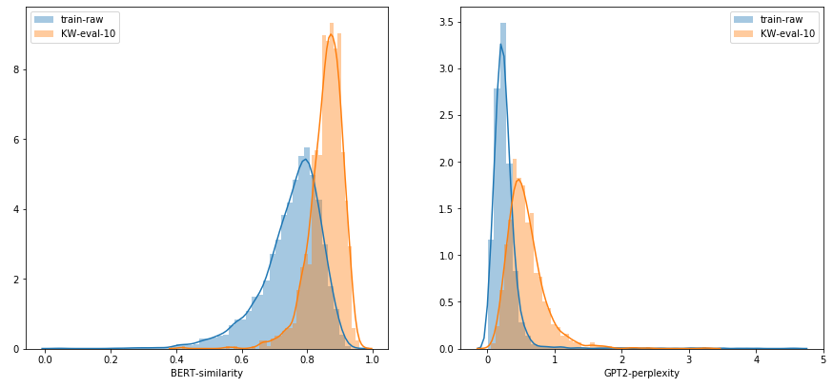
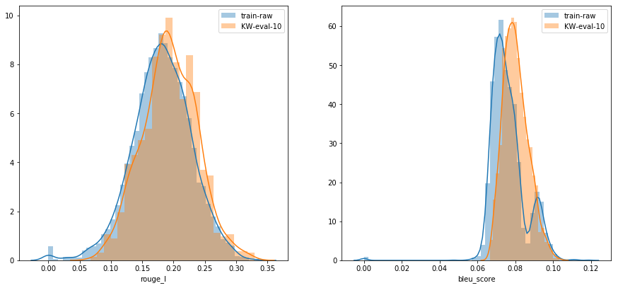
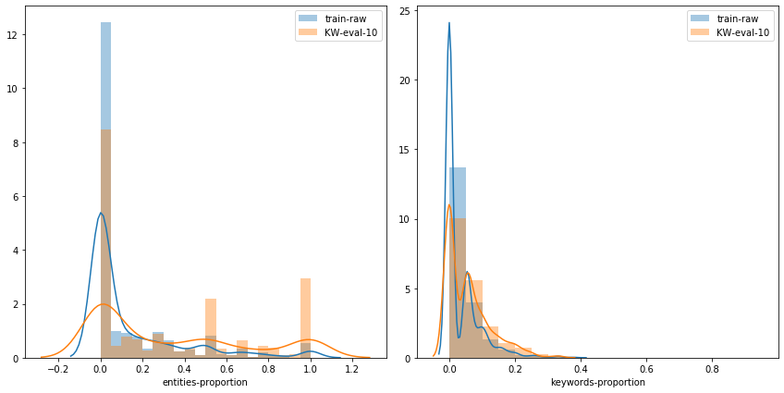
Results
Generation Example Summaries, keywords and entities highlighted
Before training
After 10 epochs
He could not conceive how he was to get within the unbroken facade of this place till he reached the street by a great open space of marble pavement to take hold of an afternoon train. For a moment he could not see the crowding. Then another group was seen, then another. He made his way slowly into the crowding in the central path. This way he was most eager to know. He had no desire to enter the city in order to get hold of some one else, to whom he could apply as little as possible to information; and so he went at once on the long platform, hoping to reach the Council House before he was in time to receive any information that he had received from his brother or his wife. After waiting several minutes for that, the expressman, who had been most unwilling to return to the city, said that he would join the Council on the way to meet the new manager, and was even more delighted to have taken possession of his money than he had been when he went to see the London cable office and asked about the interview he had held during the afternoon. The cable service had been decided after he had left it.
BERT Similarity Between Generated & Original P2
ROUGE Score
Presence of ENTITIES
BERT Perplexity
BLEU Score
Presence of KEYWORDS

Slide 15
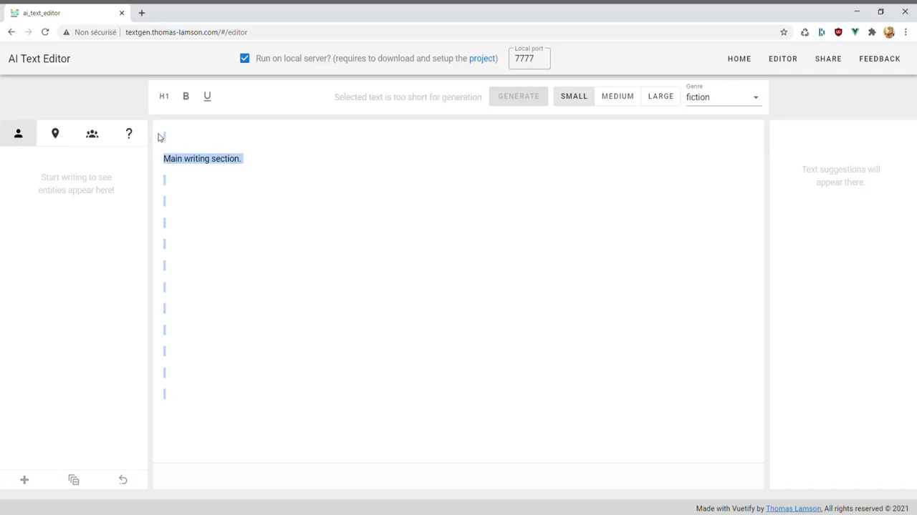
Demonstration

Slide 16
Links
Front-end only service: http://textgen.thomas-lamson.com/
GitHub project: http://github.com/ThomasLamsonFr/AITextGenerator
Front-end GitHub project: https://github.com/ThomasLamsonFr/AITextGeneratorFront
Demonstration video: https://www.youtube.com/watch?v=zwezKGrahK0
Contacts
Alexandre Duval alexandre.duval@student-cs.fr
Thomas Lamson contact@thomas-Lamson.com
Gaël de Léséleuc de Kérouara gael.dldk@pm.me
Matthias Gallé matthias.galle@naverlabs.com

